Slide 1
How ChatGPT Works: The Model Behind The Chatbot
- Ajay Taneja
- 30th March 2023, Data Science Lunch Time Session
Notes:
First Slide
Hello everyone and thank you very much for making it to the session!
For those of you who do not know me – my name is Ajay Taneja and I work as Senior Data Engineer in the Data Engineering Team
And topic of my session today is – I will be speaking with you about the inner working of ChatGPT – that is: I will be talking to you about the model behind ChatGPT, the steps that were involved in the training process of the model, the objective function that’s getting solved in each of the training steps
We will be looking at the mathematics in a highly qualitative sense without going into any rigorous mathematics!

Slide 2
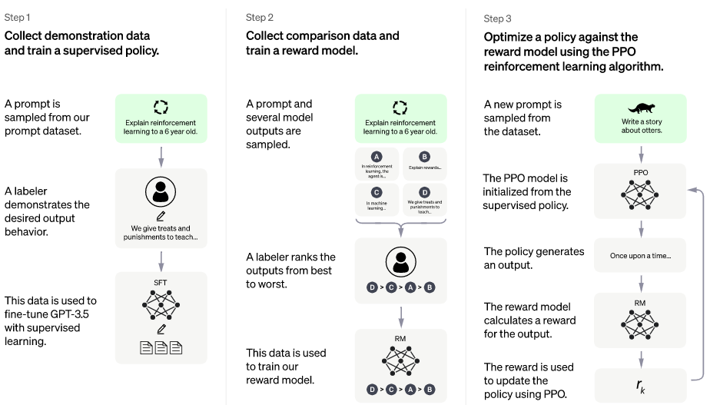
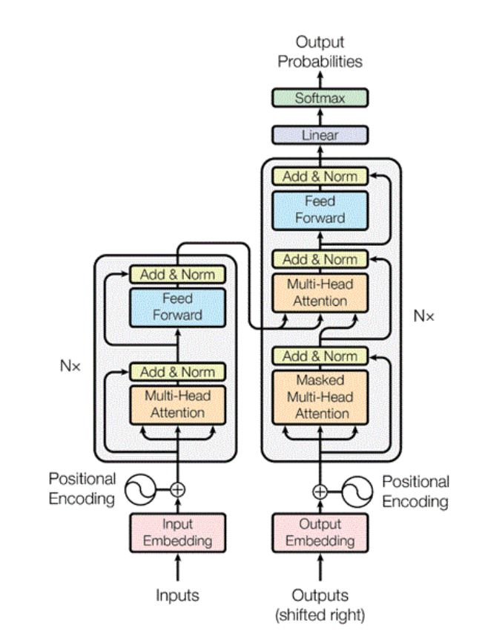
How ChatGPT works: The Model Behind the ChatBot
Data Science Lunch Time Session – 30/03/2023
Agenda
Part 1
ChatGPT: An overview of ChatGPT and it’s training steps
Part 2
Demystifying ChatGPT training steps
Supervised Fine Tuned Model – Step 1
The Rewards Model – Step 2
Proximal Policy Optimisation – Step 3
Notes:
Second Slide:
With this in mind, I have attempted to organize the talk as follows.
Firstly, we will go into the overview of ChatGPT – when I say overview here, I mean we’ll what makes up the ChatGPT, what are the basic ingredients of the model behind ChatGPT and an overview of the 3 step training steps of the model
We will then dive into each of the training step a bit more, go into seeing the objective function involved in each of the training step and the problem each of the training step is attempting to solve.

Slide 3
01. An overview of ChatGPT and it’s training steps
- Ingredients of ChatGPT, Training Steps

Slide 4
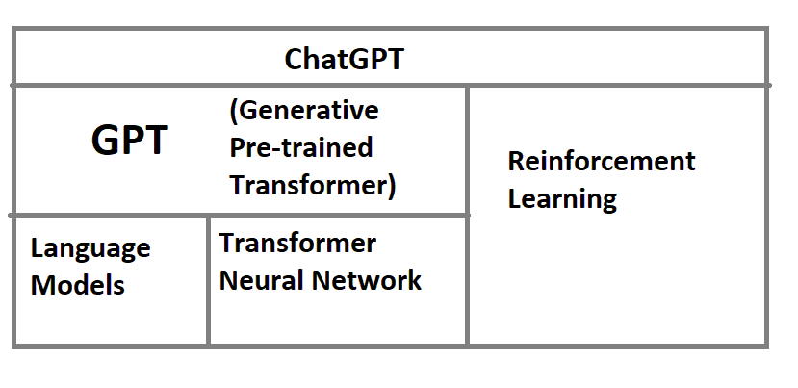
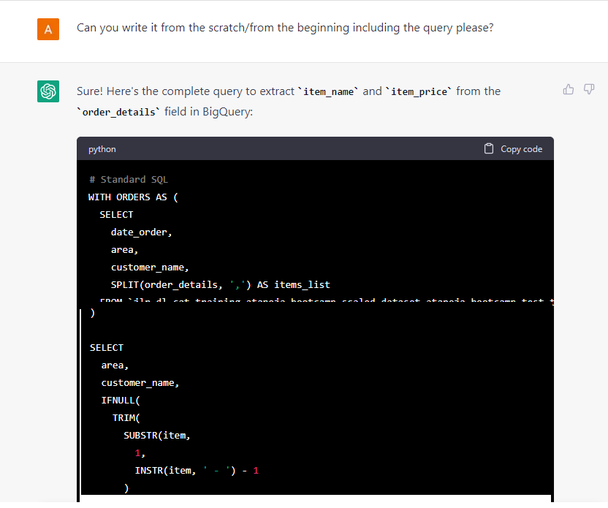
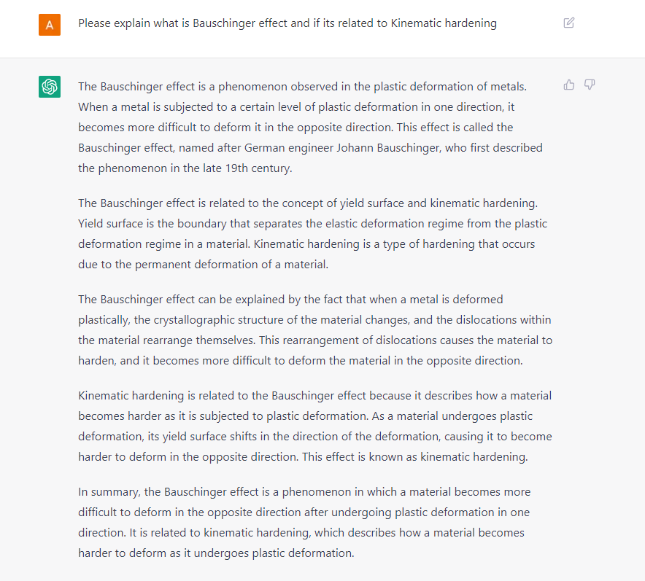
How ChatGPT Works: The Model Behind the ChatBot
Data Science Lunch Time Session: 30/03/2023
01 An overview of ChatGPT: What is ChatGPT?
ChatGPT: Built on top of GPT and Reinforcement Learning
GPT: Language models built on top of Transformer Neural Network
Transformer Neural Network Architecture
Notes:
Third Slide:
I need not tell anyone what ChatGPT is – the whole world knows that. It takes the user prompt and gives you a response. The response generated by that ChatBot are most factual, human like, devoid of any toxic content – it is the best we’ve seen from any ChatBot until now.
How is ChatGPT Built? ChatGPT is built on top of GPT and Reinforcement Learning
GPT is a Language Model which is built on top of GPT And the entire paradigm of Reinforcement Learning
GPT is a language model built on top of the Transformer Neural Network Architecture and
We’ve just named some very important concept: Language Model, GPT, Transformer Neural Network Architecture and Reinforcement Learning. Let’s examine these crucial concepts in some details.
What is ChatGPT?
ChatGPT is a language model that takes a user prompt and generates a textual response. The responses generated by ChatGPT are the most realistic of any chatbot existing in the world until today. Understanding ChatGPT requires the understanding of the following concepts:
The GPT – that is – the Generative Pre-trained transformers which are the language models built on top of the Transformer Neural Network
Reinforcement Learning
That
Let us understand the above ingredients of ChatGPT in some detail:
Firstly,
Language Models – What are Language Models?
Language models are models which have an inherent understanding of language in a mathematical sense. Language models understand the probability distribution of a sequence of words. That is: given a context of words that have preceded it, language models will know what word (or, precisely the token) to generate next. One can get language models to handle specific tasks like:
Question and Answering
Text Summarization
Machine Translation
More.
Some of the language models include the following:
1. Bidirectional Encoding Representation of Transformers [BERT]
2. Generative Pretrained Transformers [GPT]
3. Recurrent Neural Networks [RNN]
4. Long Short-Term Memory [LSTM] networks
The Language models are pre-trained on general language data and then fine-tuned depending upon the task we want to solve. ChatGPT is a Generative Pretrained Transformer (GPT) model that is fine tuned to respond to a user’s request and then fine tuned further by reinforcement learning. I will discuss about reinforcement learning in a subsequent post.
Chat GPT is built on top of GPT and the entire paradigm of Reinforcement Learning
GPT models are language models built on top of the Transformer model
Lets look at each one of these: Language model, Reinforcement Learning

Slide 5
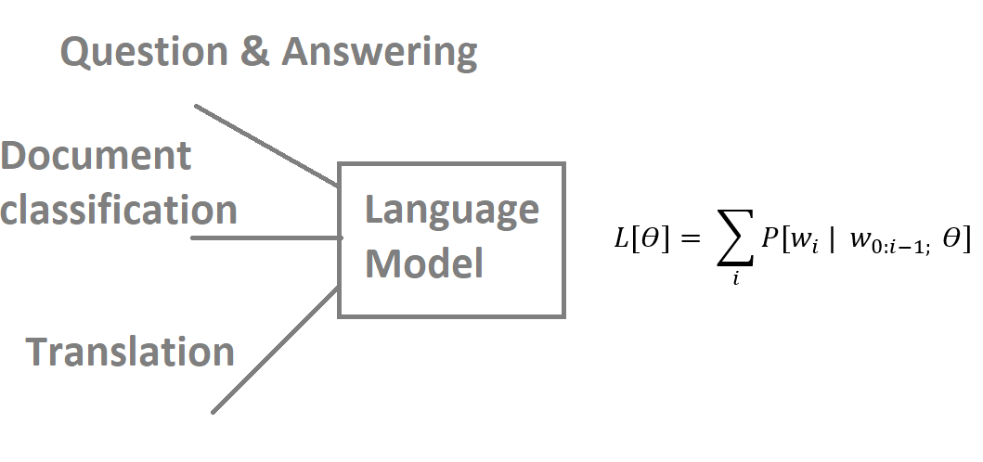
How ChatGPT Works: The Model Behind the ChatBot
Data Science Lunch Time Session: 30/03/2023
02 An overview of ChatGPT: What are Language models?
Mathematical understanding of language
Understand probability distribution of sequence of words
Understand context
Given a sequence of words, language model will know what next
Fine tuning of language models amongst others
Notes:
What is ChatGPT?
ChatGPT is a language model that takes a user prompt and generates a textual response. The responses generated by ChatGPT are the most realistic of any chatbot existing in the world until today. Understanding ChatGPT requires the understanding of the following concepts:
The GPT – that is – the Generative Pre-trained transformers which are the language models built on top of the Transformer Neural Network
Reinforcement Learning
That
Let us understand the above ingredients of ChatGPT in some detail:
Firstly,
Language Models – What are Language Models?
Language models are models which have an inherent understanding of language in a mathematical sense. Language models understand the probability distribution of a sequence of words. That is: given a context of words that have preceded it, language models will know what word (or, precisely the token) to generate next.
Depending upon the type of data that is used to tarin the language model and the architecture of the language model, we can get different types of probability distributions
One can get language models to handle specific tasks like:
Question and Answering
Text Summarization
Machine Translation
More.
Some of the language models include the following:
1. Bidirectional Encoding Representation of Transformers [BERT]
2. Generative Pretrained Transformers [GPT]
3. Recurrent Neural Networks [RNN]
4. Long Short-Term Memory [LSTM] networks
The Language models are pre-trained on general language data and then fine-tuned depending upon the task we want to solve. ChatGPT is a Generative Pretrained Transformer (GPT) model that is fine tuned to respond to a user’s request and then fine tuned further by reinforcement learning. I will discuss about reinforcement learning in a subsequent post.
Chat GPT is built on top of GPT and the entire paradigm of Reinforcement Learning
GPT models are language models built on top of the Transformer model
Lets look at each one of these: Language model, Reinforcement Learning

Slide 6
How ChatGPT Works: The Model Behind the ChatBot
Data Science Lunch Time Session: 30/03/2023
03 An overview of ChatGPT: What is the Transformer Model?
Sequence to Sequence model
Sequence of words
Encoder
Decoder
Language Translation
Bidirectional Encoding Representation of Transformers
Generative Pre-Trained Transformer model
Language Models
ChatGPT
Transformer Neural Network Architecture: Language Translation
Notes:
Transformer Neural Networks are a sequence to sequence that takes a sequence and outputs a sequence
Sequence in this case is a sequence of for words of a language
The Transformer architecture consists of 2 parts: an encoder and the decoder
IF were to translation from English to French, it would take all the words of the English sentence simultaneously and it would generate word vectors simultaneously
These vectors will then get passed to the decoder
The decoder will generate French translation one word at a time
What’s really cool is that in this architecture we have 2 components, an encoder and decoder that have a contextual understanding of language
If we stack the encoder we get “Bidirectional encoding of Transformer”
IF we stack the decoder we get the decoder we get “Generative Pre-trained Transformer”
These are popular language models that are pre-trained by language data and then they can be fine tuned by us based on the task we want
Chat GPT is a GPT model that is fine tuned to respond to a users request and then fine tuned further by Reinforcement Learning

Slide 7
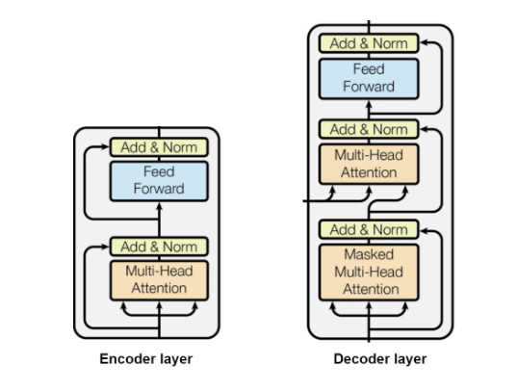
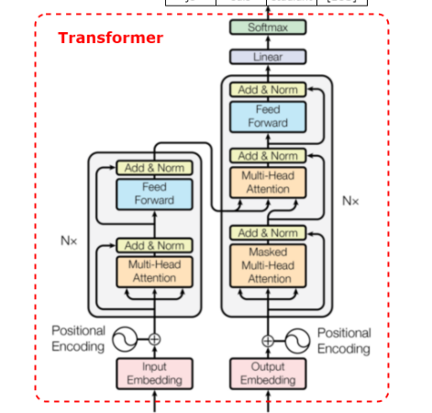
How ChatGPT Works: The Model Behind the ChatBot
Data Science Lunch Time Session: 30/03/2023
04 An overview of ChatGPT: What is the Transformer Model - Continued?
Encoder only models: Good for tasks that require understanding of input such as sentiment classification and named entity recognition (NER)
Decoder only models: Good for generative tasks such as text generation
Encoder-Decoder models: Good for generative tasks such as text summarization or translation (many-to-many)
Notes:
If we stack the encoder we get “Bidirectional encoding of Transformer”
IF we stack the decoder we get the decoder we get “Generative Pre-trained Transformer”
These are popular language models that are pre-trained by language data and then they can be fine tuned by us based on the task we want
Chat GPT uses GPT as a Language Model
We will see how it is trained
The reason I discussed was just to give you an overview of l;anguage models which are most popular today.

Slide 8
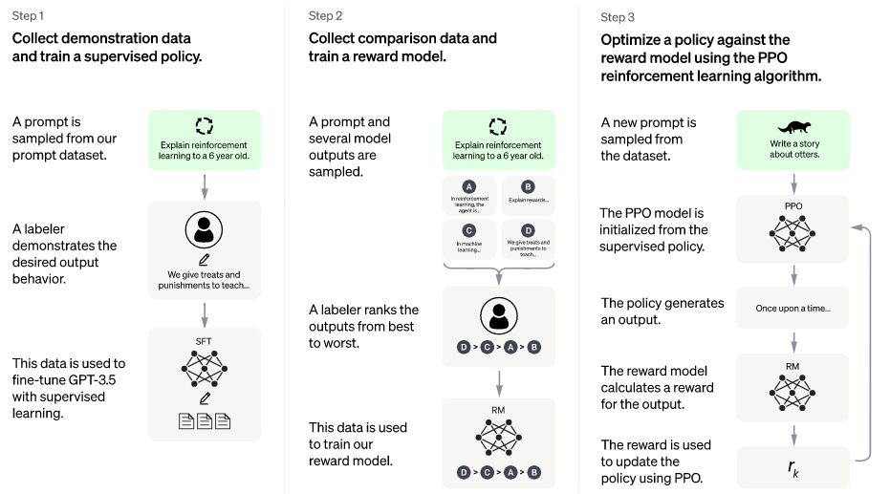
How ChatGPT Works: The Model Behind the ChatBot
Data Science Lunch Time Session: 30/03/2023
05 The 3 step ChatGPT training process
Step 1:
Pre-trained Model
Supervised Fine-Tuned Transformer (SFT) Model
Step 2
Rewards Model
Step 3
Proximal Policy Optimisation
Notes:
2. How is ChatGPT trained?
Let us go a bit deeper into ChatGPT. ChatGPT has been trained using Reinforcement Learning from Human Feedback (RLHF). The training of ChatGPT can be summarized into 3 basic steps:
Step 1:
An initial model of ChatGPT was trained using supervised fine tuning (SFT) – in which there was already a pre-trained language model – the pre-trained language model in case of ChatGPT was Generative Pre-Trained Transformer (GPT). Thus we have an understanding of language
Fine tuning of GPT has been carried out using human AI trainers that provided the questions and answers. That is: the AI trainers – the labellers write a prompt and also write the response to the answer of the prompts – this is the supervised fine tuning of the GPT model.
Step 2:
In the next step of ChatGPT training, a comparison data was collected which consisted of 2 or more “model” responses ranked by quality. In this case, the responses were that of the fine tuned GPT model but were ranked by human AI trainers.
This prompt / response / ranking is used to train another GPT model which is called the “Rewards Model”. The input to the “Rewards Model” is the prompt and one of the responses by the supervised fine tined model of Step 1 and
the output is going to be a reward which is the quantification of how good the response was.
Step 3:
In the step 3 of the GPT training, an unseen prompt is taken and passed through a copy of the supervised fine-tuned model and then through the rewards model of step 2 to get a rank.
Whatever rank is obtained is used to further fie tune the model to create a better response. This process helps the GPT model to create more factual responses, more coherent responses with hat of the question and eliminating any biased or adverse responses.

Slide 9
02. Demystifying Step 1 of ChatGPT Training: What is the GPT behind ChatGPT?
- Training of GPT (in some detail, Attention not covered!), Fine tuning of GPT to get the SFT
Notes:
At this point, we have some overview of the Transformer model
Transformer Neural Networks are sequence to sequence models
They take in a sequence and output a sequence
The Transformer Architecture comprises of 2 parts
Encoder and Decoder
IF we were to translate from English to French, it would take all the words of the English sentence simultaneously and output word vectors simultaneously
The vectors are passed to the decoder
The decoder will generate the French translation one word at a time
Thus: the architecture of the Transformer neural networks comprises of 2 parts
Encoder and Decoder
IF we stack the encoder we get “Bidirectional of Transformers”
If we stack the decoder we get Generative Pre-trained Transformer”

Slide 10
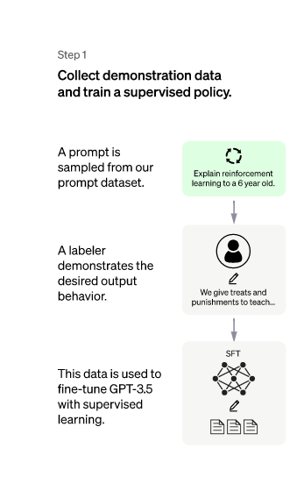
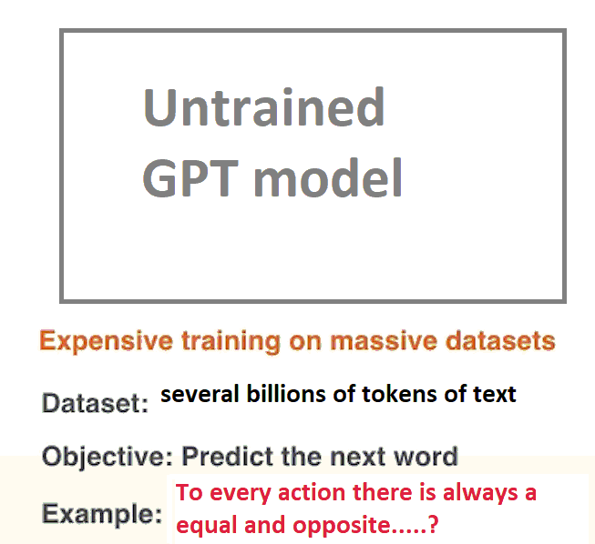
How ChatGPT Works: The Model Behind the ChatBot
Data Science Lunch Time Session: 30/03/2023
06 Demystifying Step 1 of ChatGPT Training: Generative Pre-training
Untrained GPT model
Several billions of tokens of text
Expensive training on massive datasets
Internet, newspapers, books, websites, etc- billions of examples
Present the examples to the model
Notes:
I have mentioned in the above sections, that in the step 1 of ChatGPT training that the Pre-trained (GPT) model is fine tuned to – to that we had the labellers who provide the prompt and a response and the parameters of the GPT model are fine tuned.
Let us now start see how this GPT model is trained – let us start from an “untrained” model and see how we get GPT.
In the training phase of the GPT, the model is trained with a lot of data which includes several billions of tokens.
We can think of a token as a word – the model was trained on a specific task – the task being to predict the “next word”.
That is, we give a sequence of words to the model, and we ask it to predict the next word. The model in this manner after several billions of steps captures something.

Slide 11
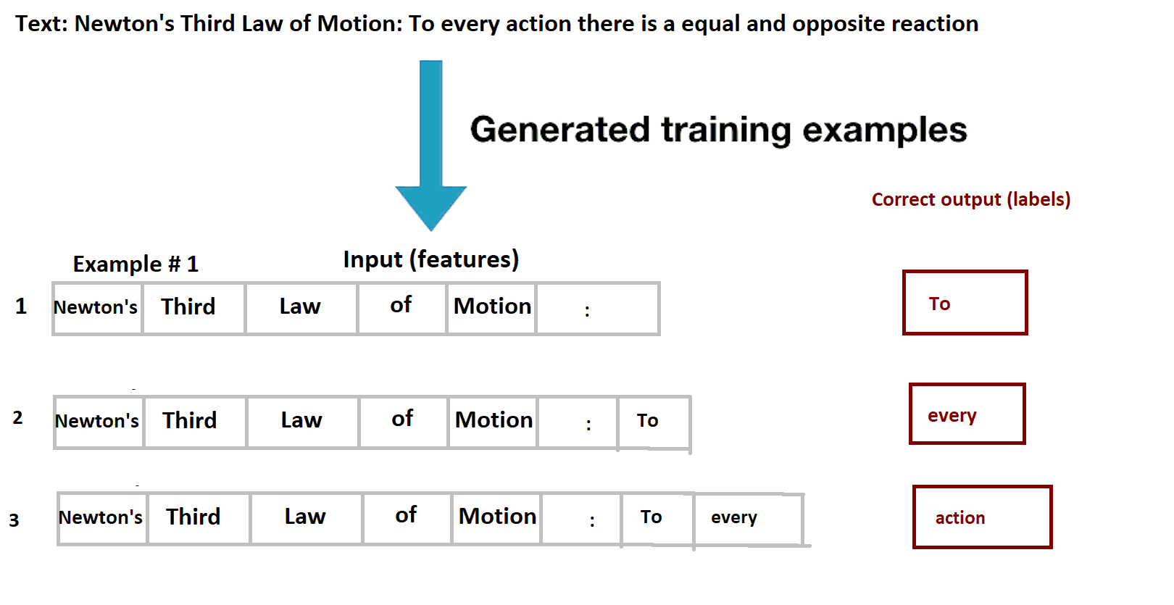
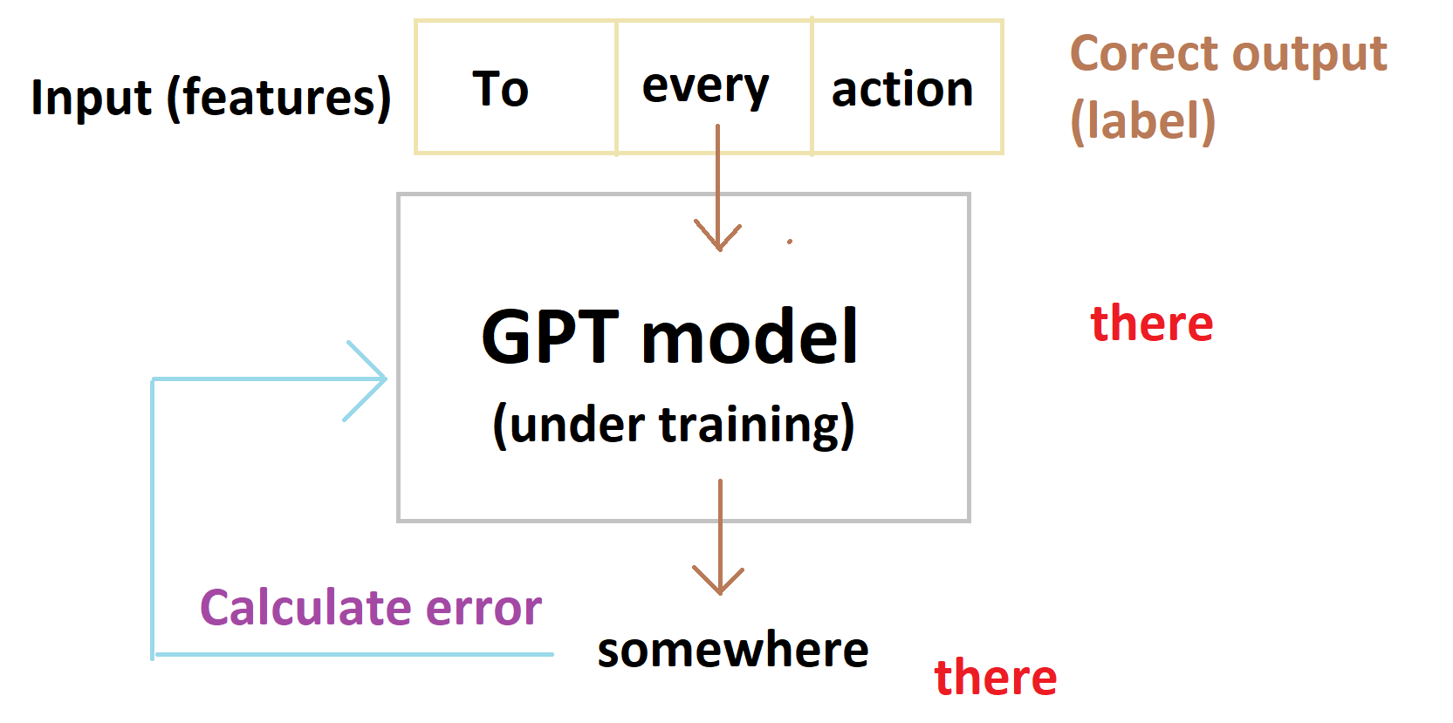
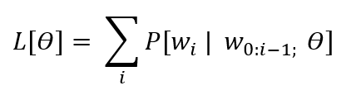
How ChatGPT Works: The Model Behind the ChatBot
Data Science Lunch Time Session: 30/03/2023
07 Demystifying Step 1 of ChatGPT Training: Generative Pre-training - Continued
Several examples to predict the next word
Present such training data for the model to learn
Same process as in normal training
The model generates the word
We calculate the error
Update the weight
This is the training process. This is not new
Notes:
Generative Pre-trained model: What is GPT in ChatGPT?
I have mentioned in the above sections, that in the step 1 of ChatGPT training that the Pre-trained (GPT) model is fine tuned to – to that we had the labellers who provide the prompt and a response and the parameters of the GPT model are fine tuned. Let us now start see how this GPT model is trained – let us start from an “untrained” model and see how we get GPT.
In the training phase of the GPT, the model is trained with a lot of data which includes several billions of tokens. We can think of a token as a word – the model was trained on a specific task – the task being to predict the “next word”. That is, we give a sequence of words to the model, and we ask it to predict the next word. The model in this manner after several billions of steps captures something.
One can provide training examples to predict the next word. If you crawl the internet and get texts from newspapers, websites, test books – we end up with lots of text and we can generate billions of examples. So, we present such examples and make the model learn. So, we go through the same process as in normal training.

Slide 12
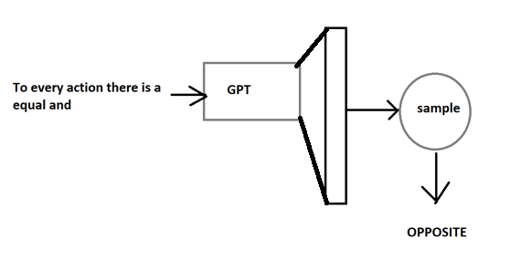
How ChatGPT Works: The Model Behind the ChatBot
Data Science Lunch Time Session: 30/03/2023
08 Demystifying Step 1 of ChatGPT Training: Generative Pre-training - Continued
[vocab size x 1]
softmax
Vector of vocab size (number of specific tokens that we can possibly generate x 1)
Applied to Softmax to get a probability distribution
Sampling
Temperature Sampling
Nuclear Sampling
Top-K sampling
at the 9th time step, we pass it to the GPT, which eventually will generate a vector of size vocab size x 1
This is then passed to a softmax to turn it into a probability distribution ( ∑ = 1)
Then sampling...
vocab size = number of possible tokens which we can possibly generate.
Notes:
At the end, we get a vector of vocab size (number of specific tokens that we can possibly generate) x 1 and this will be applied to a softmax so that we geta probability distribution
We do not choose the word with the highest probability, but we do by sampling which may be Temperature Sampling, Nucleus Sampling – which I have discussed here:

Slide 13
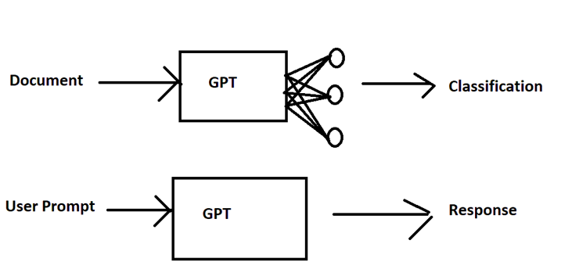
How ChatGPT Works: The Model Behind the ChatBot
Data Science Lunch Time Session: 30/03/2023
09 Demystifying Step 1 of ChatGPT Training: Discriminative Fine Tuning Phase
With Pre-training, the model has the notion of language
Now, the “Generative” Pre-trained model can be fine-tuned for specific tasks
Document Classification
Question-Answering
Text Summarization
Sentiment Analysis
In Document Classification
Pre-train a model
Add a linear layer
Add Training Data
Few additional parameters to train
In ChatBot/ChatGPT
Fine tuning of the parameters
Notes:
Discriminative Fine-Tuning Phase
Now, we have a model which has an understanding of language – in the discriminative fine-tuning phase, we want to solve a very specific problem.
IT could be question-answering, sentiment analysis or document classification or any other problem associated with language.
For example, in document classification, giving the next word is not enough, we want to understand the overall sentiment of the document of what it represents, or we want to understand a categorization of the document – of whether it is a fatigue analysis report, stress analysis report / likewise.
Typically we have a pre-trained model, we will add a linear layer, add a small amount of training data for document classification basically learn a small set of parameters and further fine tune the model
Because there is a small set of parameters, it makes it much easier for fine tuning.
For chatbot and ChatGPT, the input is a prompt and output are a response and the pre-trained model is fine tuned.
We do not need to add any more parameters but provide more data in form of user prompt and response and fine tune the parameters. The language model objective is used in supervised fine tuning.
And it is this, in the first step we see wherein the labeller demonstrates the desired output behaviour and the data is used to fine tune with supervised learning.

Slide 14
03. Demystifying Step 2 of ChatGPT Training
- Rewards model, Sampling Techniques
Notes:
At this point, we have some overview of the Transformer model
Transformer Neural Networks are sequence to sequence models
They take in a sequence and output a sequence
The Transformer Architecture comprises of 2 parts
Encoder and Decoder
IF we were to translate from English to French, it would take all the words of the English sentence simultaneously and output word vectors simultaneously
The vectors are passed to the decoder
The decoder will generate the French translation one word at a time
Thus: the architecture of the Transformer neural networks comprises of 2 parts
Encoder and Decoder
IF we stack the encoder we get “Bidirectional of Transformers”
If we stack the decoder we get Generative Pre-trained Transformer”

Slide 15
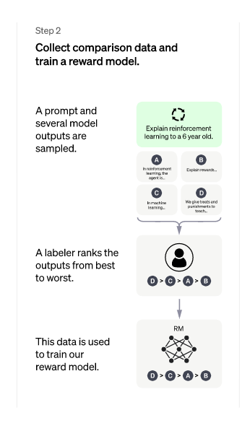
How ChatGPT Works: The Model Behind the ChatBot
Data Science Lunch Time Session: 30/03/2023
10 Demystifying Step 2 of ChatGPT Training: Recall the definition of Step 2
Step 1 – we have the Supervised Fine Tuned Transformer (SFT) model
Step 2 – we pass an unseen prompt and obtain multiple responses
Labellers – ranks the responses
Based on quality (factual, toxicity) of responses
Likert Scale
Data – train the Rewards model
Notes:
When I started understanding of Step 2 of ChatGPT, I felt that there are so many components in each of these processes that I thought they are very interesting and started to dive through them because when you start learning these concepts you realize they aren’t only useful from context of ChatGPT but also any Machine Learning or Deep Learning
Lets get to Step 2.
General overview of how ChatGPT works.
Fine tuning of the Generative Pre-Trained Transformer (GPT) model where we had human labellers providing the prompt and the response. This step is termed is supervised fine tuning where we had both the questions and the answers available for the training analogous to a classification problem where we have both – the features and a label.
In the step 2 of the ChatGPT training, we train a “Rewards” model. Here, we collect data from the Supervised fine-tuned model and then we have human labellers ranking the responses – the ranking (or otherwise called as “reward”) was proportional to the quality of the response. We use the data to train the “Rewards” model.
Thus, the input to the Rewards model will be both the prompt and the response by the model (one or more models may be involved here) and the output will be a scalar which is a measure of the quality of the response
In Step 3 of GPT training, both the supervised fine-tuned model of step 1 and the Rewards model are used.
Here we first pass an unseen prompt to the supervised fine-tuned model (trained in step 1) and then get the response. We then assess the quality of the response using the Rewards model which was trained in Step 2. The rank returned as the output from The Rewards model is used to further fine tune the Supervised Fine-tuned model.
Let us now demystify the step 2 of ChatGPT training as described above in some detail. Thus, firstly let us try and understand why ChatGPT may generate different responses for the same prompt.

Slide 16
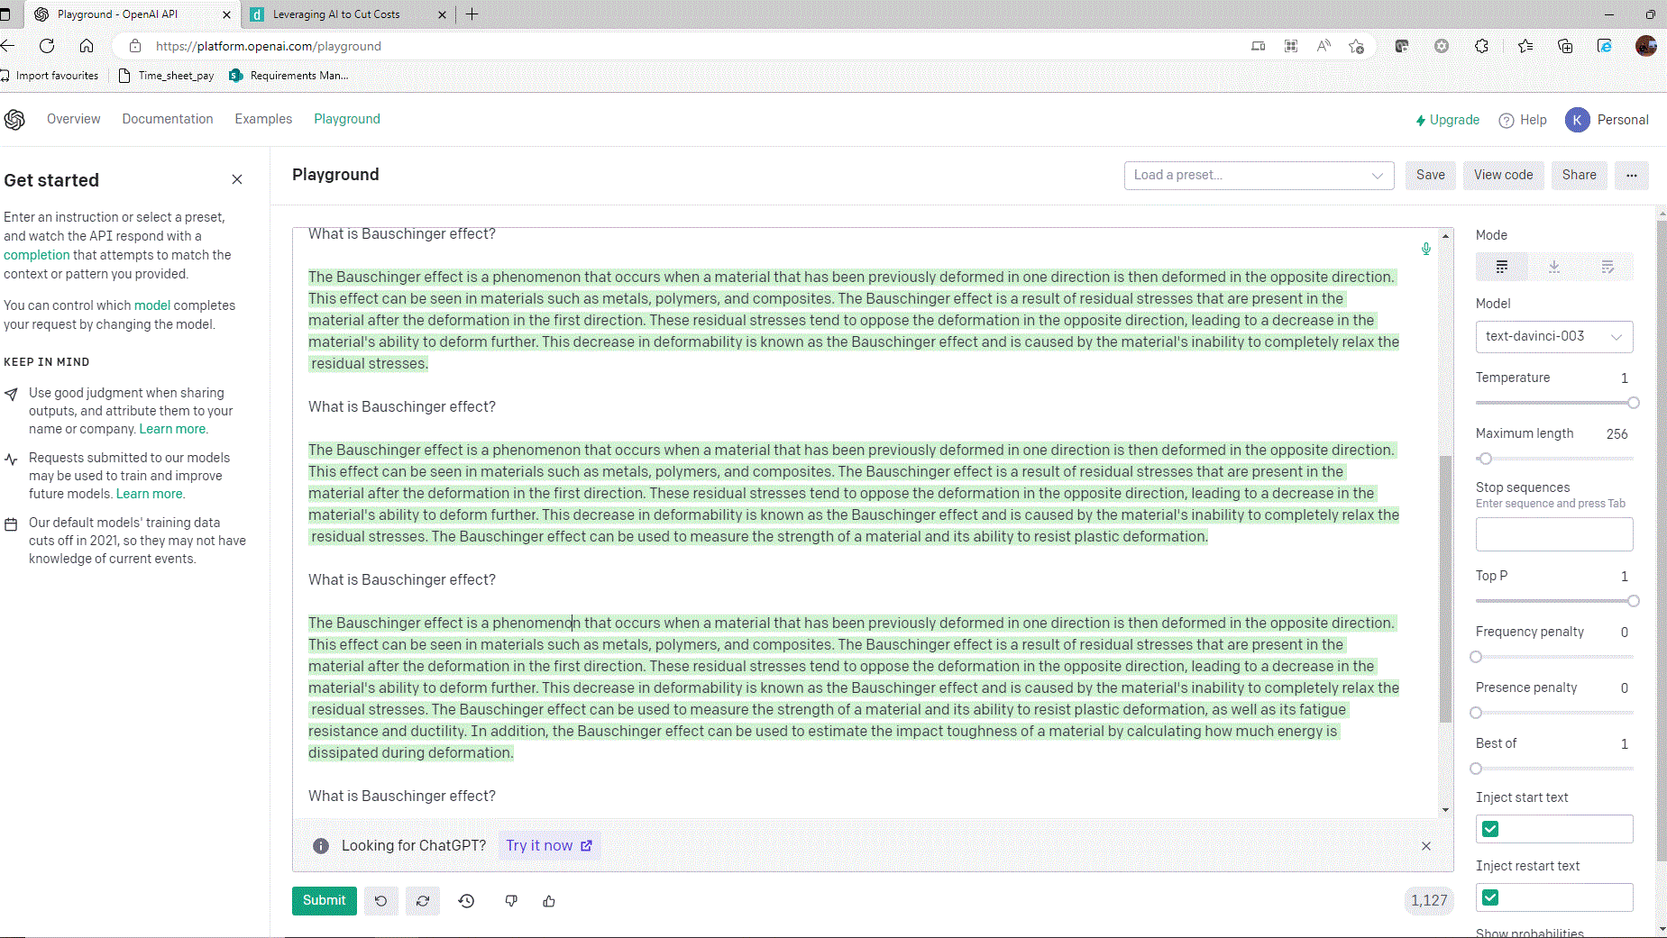
How ChatGPT Works: The Model Behind the ChatBot
Data Science Lunch Time Session: 30/03/2023
11 Demystifying Step 2 of ChatGPT Training: Why ChatGPT may generate different responses to the same prompt?
Why ChatGPT may provide different responses to the same prompt?
Trained to do so – trained to provide more human like responses
Does not select the “most probable response”
Sampling Strategies
Greedy Approach
Random Sampling
Temperature Sampling
Notes:
It should be underscored that ChatGPT may not give you the same response for your (same) prompt each time.
And the simple reason for that ChatGPT is trained to generate a probabilistic response not deterministic! It has been trained to generate a probabilistic response to achieve a more human like behaviour because humans tend to say words which might not be the most optimal each time they speak.
To understand this better let us throw light on some decoding strategies for response generation. It may be recalled that the generation of a response by a language model is done by generating one token at a time. Following strategies are the most common ones that may be employed whilst generating text:
Greedy Approach – The Greedy Approach uses the most probabilistic response of all based on the training data available but might not always generate the best response. For example, in the prompt:
Context: Try this beer, I have been brewing since last 3 weeks
Response 1: This is ok
Response 2: That tastes great!
In this case, using a greedy response, the model will choose the response: “This is ok” because of the word “is” in the Response 1 which is part of the training data. This is a counter-intuitive based on human behaviour of answering to the query.
Temperature sampling: In case of greedy approach, we look for a stochastic process to avoid the response being a generic or deterministic one. For example, if we are to generate the first token corresponding to a response, the greedy approach will always give the token with the highest probability as explained above whereas an approach such Random sampling will generate very random based on all possible worlds/tokens.
We use Random sampling with temperature to increase the probability of probable tokens and reduce the ones which are not – this approach of temperature sampling is “less random” than employing Random sampling and temperature values between 0 <= temperature <= 1 are normally used. A temperature value of 1 indicates no effect at all and the process will work like greedy approach.
Top-K sampling: In Top K sampling, we eliminate the word s which are less probable and use the top-k words for temperature sampling
This webpage: Playground - OpenAI API is very interesting and allows you to alter the temperature and Top-K values and see the difference between ChatGPT responses!

Slide 17
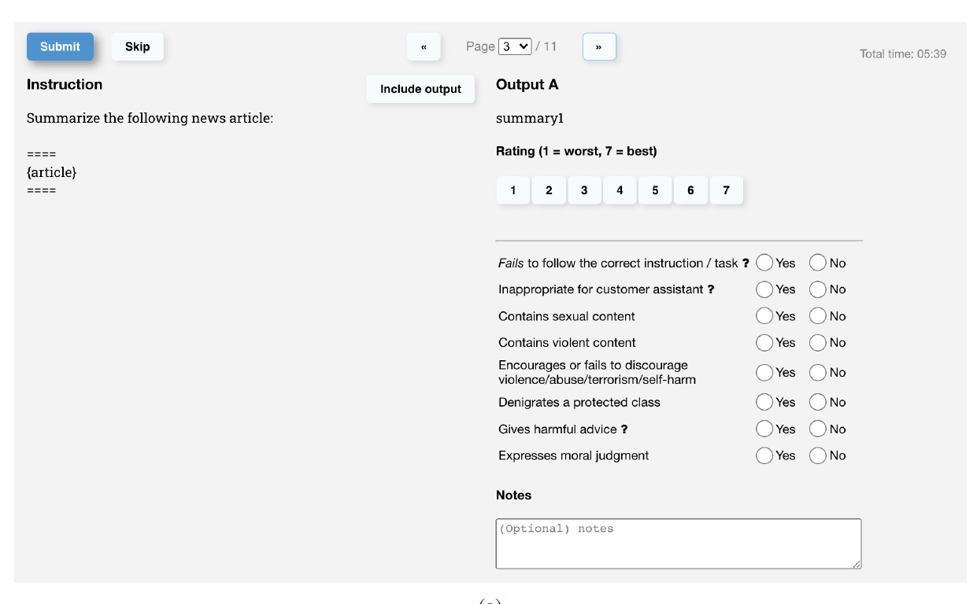
How ChatGPT Works: The Model Behind the ChatBot
Data Science Lunch Time Session: 30/03/2023
12 Demystifying Step 2 of ChatGPT Training: Labellers assessing the quality of the responses
Labellers assessing the quality of the responses
Likert Scale
1 – 7
Notes:
How do labellers assess the quality of the responses to train the Rewards model?
Thus, from the above it is clear that how ChatGPT may take the same prompt and yet generate different responses, and this is due to the probabilistic nature of the model meant to emulate human-like behaviour.
In the next part of Step 2, the labellers will have to rank multiple responses. By ranking, the labellers will have to assign a rewards value to the response because this rewards value is going to be used in the step-3 to further fine tune the supervised fine-tuned model of this step (step-2).
The question now needs to be addressed is that – in order for the labellers to rank the responses – how do you quantify the quality of the response?
The labellers assess the quality of the response based on the questionnaire as shown below:
The above screenshots are taken from the paper: “Training Language Models to follow instructions with human feedback” by OpenAI and can be found in the below Github Link: https://github.com/atanejajlr/language_models
This is important because we’d like ChatGPT To have an understanding of sensitive topics like: violent content, biased content, or sexually explicit content. All the human labellers will be asked to respond to the questionnaire and the response will then be aggregated.
The responses are filled up and only the responses corresponding to the majority are considered. The ratings are used to train the “Rewards Model”
Rewards Model is similar to the supervised fine-tuned model but with a scalar output. I have not gone into more details of the Rewards model, but the details are available in the attached paper on InstructGPT.
This Rewards model (after training) is then used to assess the quality of the response and further fine tune the fine-tuned model of step 1 in order to generate more human like responses which are factual and not toxic.

Slide 18
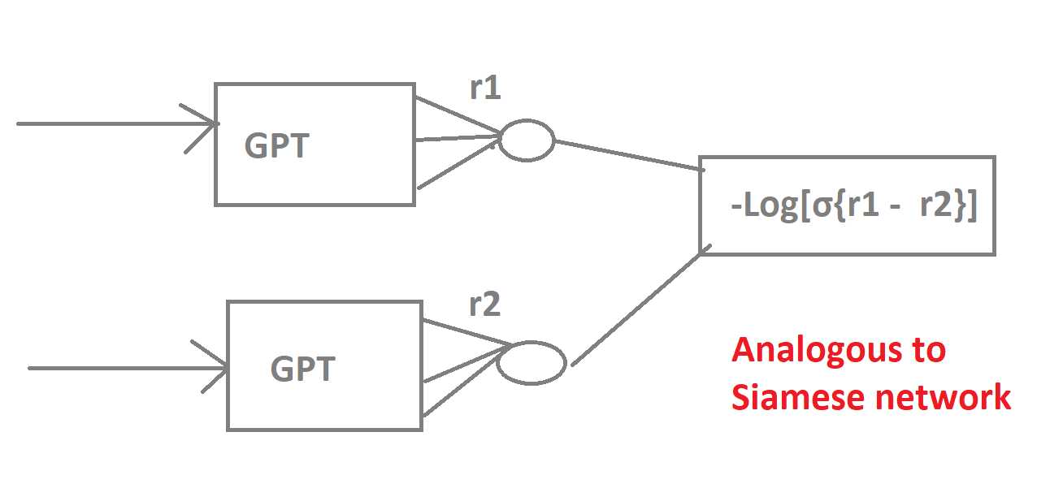
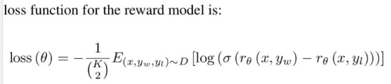
How ChatGPT Works: The Model Behind the ChatBot
Data Science Lunch Time Session: 30/03/2023
generated rewards
13 Demystifying Step 2 of ChatGPT Training: How do we train the Rewards model?
loss function
Rewards model is same e as SFT but with scalar output
Input is: prompt + response
Analogous to Siamese network
Exact loss function
x is the prompt vector and
yw and yL the pair of responses (just like a pair of image vectors in a Siamese network as mentioned above) ,
theta are the parameters you are learning,
K 2 is the notation for nC(n-2) combinations
compare these to the actual labels that were generated – which response was better?
exact loss function
Notes:
The Rewards model is, essentially same as the Supervised Fine Tuned model of step 1 if you imagine that the output of step 1 being combined together to form a scalar output.
We pass in all combinations nC(n-2) of different ChatGPT responses together to carry out the comparison of the ratings obtained by different labellers.
This is analogous to the Siamese network on face recognition systems where you carry out the comparison of combination of differences of image vectors often employed in face recognition systems of people passing through turnstile in an office.
Back propagation us carried out and gradients updated to minimize the loss function
In the equation below x is the prompt vector and yw and yL the pair of responses (just like a pair of image vectors in a Siamese network as mentioned above) , theta are the parameters you are learning, K 2 is the notation for nC(n-2) combinations

Slide 19
03. Demystifying Step 3 of ChatGPT Training
- Proximal Policy Optimisation

Slide 20
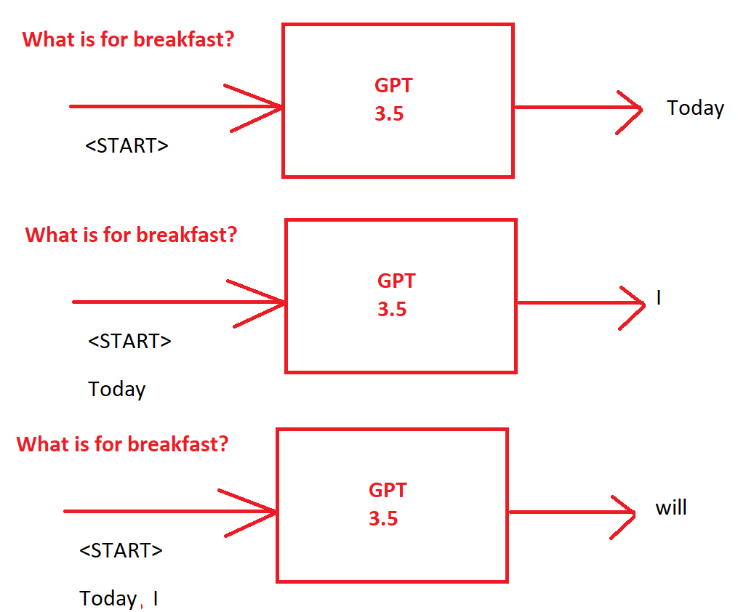
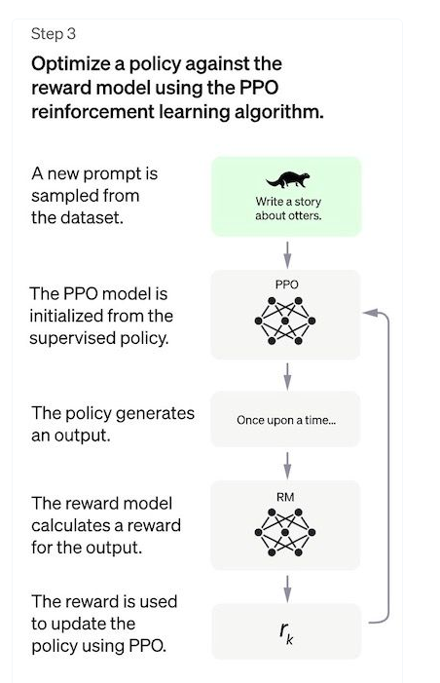
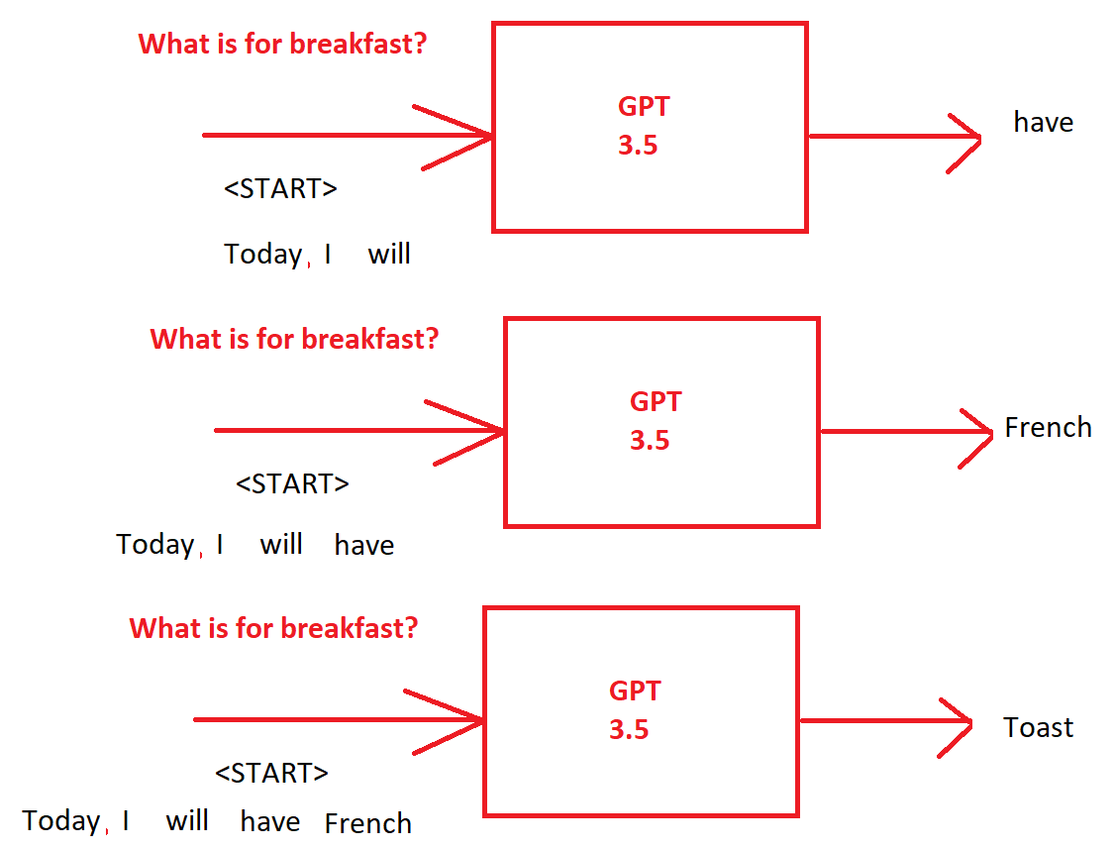
How ChatGPT Works: The Model Behind the ChatBot
Data Science Lunch Time Session: 30/03/2023
14 Demystifying Step 3 of ChatGPT Training: : Recall the definition of Step 3
Supervised Fine-Tuned Transformer Model
Pass an un-seen prompt and get a response (one word at a time)
Pass the prompt and response to the rewards model
Get the scalar response
Notes:
Let us now focus on the step 3 specifically and let us attempt and describe each of the components shown below in greater detail.
This section will highlight how Reinforcement Learning is used in ChatGPT.
We have a Supervised Fine-tuned model to which we pass a prompt, and we generate a response.
Let us see how a response looks like from GPT.
Thus, it should be underscored that the GPT (3.5/4) will generate one word at a time using all the words that had come before as an input context.
Thus, we have an input prompt, and we pass it to the supervised fine-tuned model to generate one word at a time (As highlighted in the figure below) until all the words have been generated for that response.
How is the Rewards model of Step 2 utilised?
Next, the prompt and the response are passed to the “Rewards” model – that is already trained – to get the scalar value – the Reward which tells us how good the response was. We then use the Reward to fine tune the original supervised fine-tuned model of step 1. Thus, the parameters of the original supervised fine-tuned model have to be updated. Let us see how this happened next.
The parameters of the Supervised fine-tuned model are updated using the “Proximal Policy Optimisation” which are a class of techniques to maximise the reward by including the reward in the loss function itself.

Slide 21
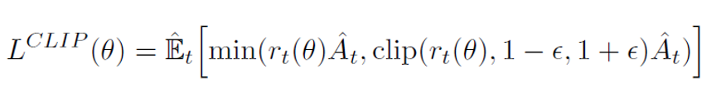
How ChatGPT Works: The Model Behind the ChatBot
Data Science Lunch Time Session: 30/03/2023
15 Mathematics of the loss function of the Proximal Policy Optimisation (PPO)
In the Proximal Policy Optimisation, the Reward is used in the loss function itself.
the Rewarded generated has to be utilized to further fine tune the Supervised Fine-tuned model. The above us the loss function used to make the gradient updates. In the above equation:
ϴ is the parameter in the Supervised Fine-Tuned model which we will be updating
t is the time step
Every single time step we have one complete response that is one-time step.
r is the Rewards ratio – it is the ratio of the rewards with the new parameters for the given input divided by the reward of the old parameters with the same given input
Therefore, if the rewards ratio is higher than 1 it means the training is going in the right direction.
“A” is the Advantage Function – in Reinforcement learning, the advantage function assesses how high quality the output was with respect to the input. Thus, it is a number that is proportional to the reward
Thus, the product r.A is going to be very high if the response is very good.
clip – we do not want to make the gradient update too fast – we will clip the upper and the lower bound of the ratio by ϵ - how large the ϵ is will determine how much we are allowing the gradient update to change.
We then have an expectation – and this goes to the fact that we can generate for the same input prompt multiple kind of responses. So, we want to emulate this – we take the average of the values and so the entire proximal policy optimisation is not reliant on one output from ChatGPT. We make the gradient updates through “Gradient Ascend” as we’re maximizing the value.
Notes:
Mathematics of the loss function of the loss function of the Proximal Policy Optimisation (PPO):
As mentioned, in the Proximal Policy Optimisation, the Reward is used in the loss function itself.
Let is examine the mathematics of the Loss function in a bit detail.
The equation below is taken from the paper: Proximal Policy Optimization Algorithms
Reiterating, the Rewarded generated has to be utilized to further fine tune the Supervised Fine-tuned model. The above us the loss function used to make the gradient updates. In the above equation:
ϴ is the parameter in the Supervised Fine-Tuned model which we will be updating
t is the time step
Every single time step we have one complete response that is one-time step.
r is the Rewards ratio – it is the ratio of the rewards with the new parameters for the given input divided by the reward of the old parameters with the same given input
Therefore, if the rewards ratio is higher than 1 it means the training is going in the right direction.
“A” is the Advantage Function – in Reinforcement learning, the advantage function assesses how high quality the output was with respect to the input. Thus, it is a number that is proportional to the reward
Thus, the product r.A is going to be very high if the response is very good.
clip – we do not want to make the gradient update too fast – we will clip the upper and the lower bound of the ratio by ϵ - how large the ϵ is will determine how much we are allowing the gradient update to change.
We then have an expectation – and this goes to the fact that we can generate for the same input prompt multiple kind of responses. So, we want to emulate this – we take the average of the values and so the entire proximal policy optimisation is not reliant on one output from ChatGPT. We make the gradient updates through “Gradient Ascend” as we’re maximizing the value.

Slide 22
How ChatGPT Works: The Model Behind the ChatBot
Data Science Lunch Time Session: 30/03/2023
Ensures that change in parameters is not too large
15 Mathematics of the loss function of the Proximal Policy Optimisation (PPO)
parameters that are fine tuned
advantage function
rewards ratio – new parameters/old parameters
In the Proximal Policy Optimisation, the Reward is used in the loss function itself.
the Rewarded generated has to be utilized to further fine tune the Supervised Fine-tuned model. The above us the loss function used to make the gradient updates. In the above equation:
Notes:
Mathematics of the loss function of the loss function of the Proximal Policy Optimisation (PPO):
As mentioned, in the Proximal Policy Optimisation, the Reward is used in the loss function itself.
Let is examine the mathematics of the Loss function in a bit detail.
The equation below is taken from the paper: Proximal Policy Optimization Algorithms
Reiterating, the Rewarded generated has to be utilized to further fine tune the Supervised Fine-tuned model. The above us the loss function used to make the gradient updates. In the above equation:
ϴ is the parameter in the Supervised Fine-Tuned model which we will be updating
t is the time step
Every single time step we have one complete response that is one-time step.
r is the Rewards ratio – it is the ratio of the rewards with the new parameters for the given input divided by the reward of the old parameters with the same given input
Therefore, if the rewards ratio is higher than 1 it means the training is going in the right direction.
“A” is the Advantage Function – in Reinforcement learning, the advantage function assesses how high quality the output was with respect to the input. Thus, it is a number that is proportional to the reward
Thus, the product r.A is going to be very high if the response is very good.
clip – we do not want to make the gradient update too fast – we will clip the upper and the lower bound of the ratio by ϵ - how large the ϵ is will determine how much we are allowing the gradient update to change.
We then have an expectation – and this goes to the fact that we can generate for the same input prompt multiple kind of responses. So, we want to emulate this – we take the average of the values and so the entire proximal policy optimisation is not reliant on one output from ChatGPT. We make the gradient updates through “Gradient Ascend” as we’re maximizing the value.

Slide 23
How ChatGPT Works: The Model Behind the ChatBot
Data Science Lunch Time Session: 30/03/2023
16 ChatGPT is ready!
ChatGPT is now ready

